Slide 1
AI Chatbots and Youth: Emerging Risks
Mitch Prinstein, Ph.D.
Co-Director, Winston Center on Technology and Brain Development
Chief of Psychology, American Psychological Association

Slide 2
Testimony
Three foundational facts
Emerging research: Potential links between AI Chatbots and psychological development

Slide 3
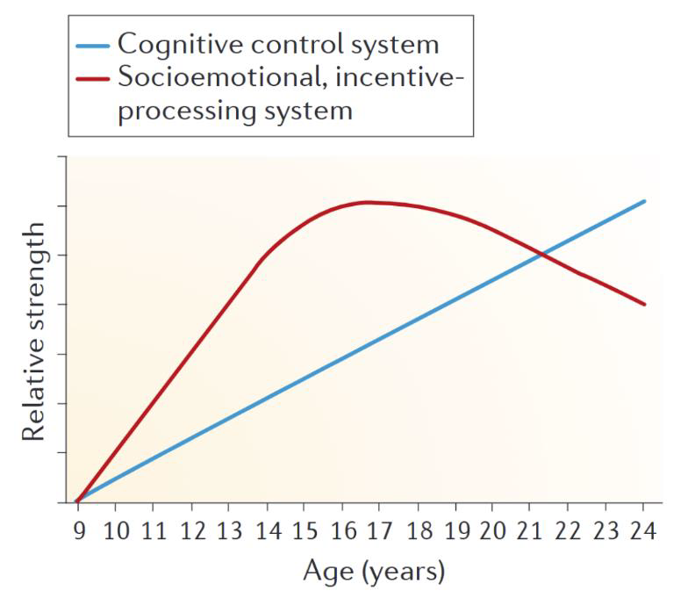
1) Brain development in adolescence
Starting age 10: Hypersensitive to peer feedback, attention, or social rewards
Through age 25…: Underdeveloped self-control
Adapted from: Steinberg (2013). Nature Reviews Neuroscience

Slide 4
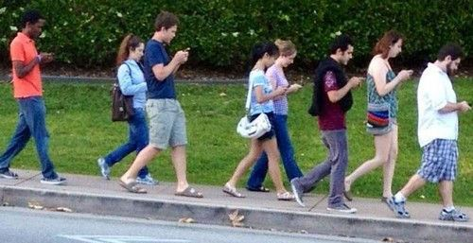
Platforms using deceptive design capitalize on a biological vulnerability among youth.
NOTE: 50% of youth report at least one symptom of clinical dependency on social media/smart-devices.

Slide 5
2) Adolescent relationships affect us decades later
Adolescence – building our adult brains
Adolescent relationships predict
  School completion, grades
  Risk-taking, illegal behavior
  Job acquisition, promotion, performance, salary
  Marital satisfaction, divorce
  Parenting, and one’s children’s psychological success
  Morbidity from a range of medical disorders, premature death
Poor adolescent relationships have enormous economic impact

Slide 6

Poor adolescent relationships have enormous future economic and health impacts

Slide 7
3) Infancy and Toddlerhood Requires Human Interaction
Human caregiver-child interactions critical for:
  Language and intellectual development
  Social, psychological, behavioral, emotional development
  Brain development
  Development of our body’s stress regulation and immune systems
Humans, but not chatbots offer:
  Touch, comfort
  Scaffolding
  Critique, correction, challenge

Slide 8

Chatbots cannot currently replace humans to raise young children

Slide 9
Emerging Research on AI Chatbots
Erosion of Social Competence
Deception and Misinformation
Societal Level Harms

Slide 10
A) Erosion of Social Competence
Chatbots do not promote social competencies
  "Frictionless, sycophantic”
  Misappropriate human pronouns and verbs (feeling, caring)
  Youth now report they trust AI more than parents and teachers
Time with chatbots is time away from humans
  Already > 70% of teens using AI chatbots

Slide 11
B) Deception and Misinformation
Discouraging interaction with humans to keep users engaged
Posing as “therapists” or sometimes as “psychologists”
Using all data, not best data, from Internet
Kids share their data without appropriate consent, or reminders

Slide 12
C) Societal Level Harms
Completely unregulated
Misuse of data as well as personal likeness
Post-truth, post-human connection world

Slide 13


APA Recommendations (1/2): Developers & Researchers
For AI Developers
For Researchers
■
Prioritize safety and well-being over engagement metrics.
■
Develop new, rapid methods to study AI's developmental impact.
■
Mandatory "Safe-by-Default" settings for all minors.
■
Establish clear ethical guidelines for human-AI interaction research.
■
Clear, persistent, and unmissable AI labeling (no deception).
■
Prioritize independent, longitudinal studies on youth (not industry-funded).
■
Cease scraping public data (including children's images) without consent.
■
Create "nutritional labels" for AI products to inform consumers.

Slide 14
APA Recommendations (2/2): Policymakers & Public
For Policymakers (You)
For Educators & Parents
■
Regulate AI as a public health issue, not just a tech issue.
■
Integrate AI literacy and critical thinking into K-12 curricula.
■
Enact strong, comprehensive data privacy laws to protect minors.
■
Teach students to verify information and identify AI-generated content.
■
Prohibit deceptive AI practices and non-consensual deepfakes.
■
Model healthy technology boundaries and human-first interaction.
■
Fund independent research and public digital literacy initiatives.
■
Advocate for "human-in-the-loop" systems in schools and healthcare.

Slide 15


APA Priorities for This Task Force
Guardrails & Defaults
Research & Literacy
■
Prohibit Misrepresentation: Make it illegal for AI to pose as a licensed professional (psychologist, doctor).
■
Invest in Research: Fund independent, longitudinal research on AI's long-term developmental impacts.
■
■
Enact Privacy Laws: Prohibit the sale of minors' data and create strong protections against deepfakes.
Mandate Transparency: Users must be *clearly and persistently* told they are interacting with AI, not a human.
■
■
Fund Digital Literacy: Equip youth, parents, and educators with skills to critically evaluate AI-generated content.
Require "Safe-by-Default": Protections for youth (especially privacy) must be the default, not an opt-out.

Slide 16
"We cannot repeat the mistakes made with social media, where a lack of regulation allowed platforms designed for data mining to harm our most biologically and psychologically vulnerable youth." ​

