Slide 1
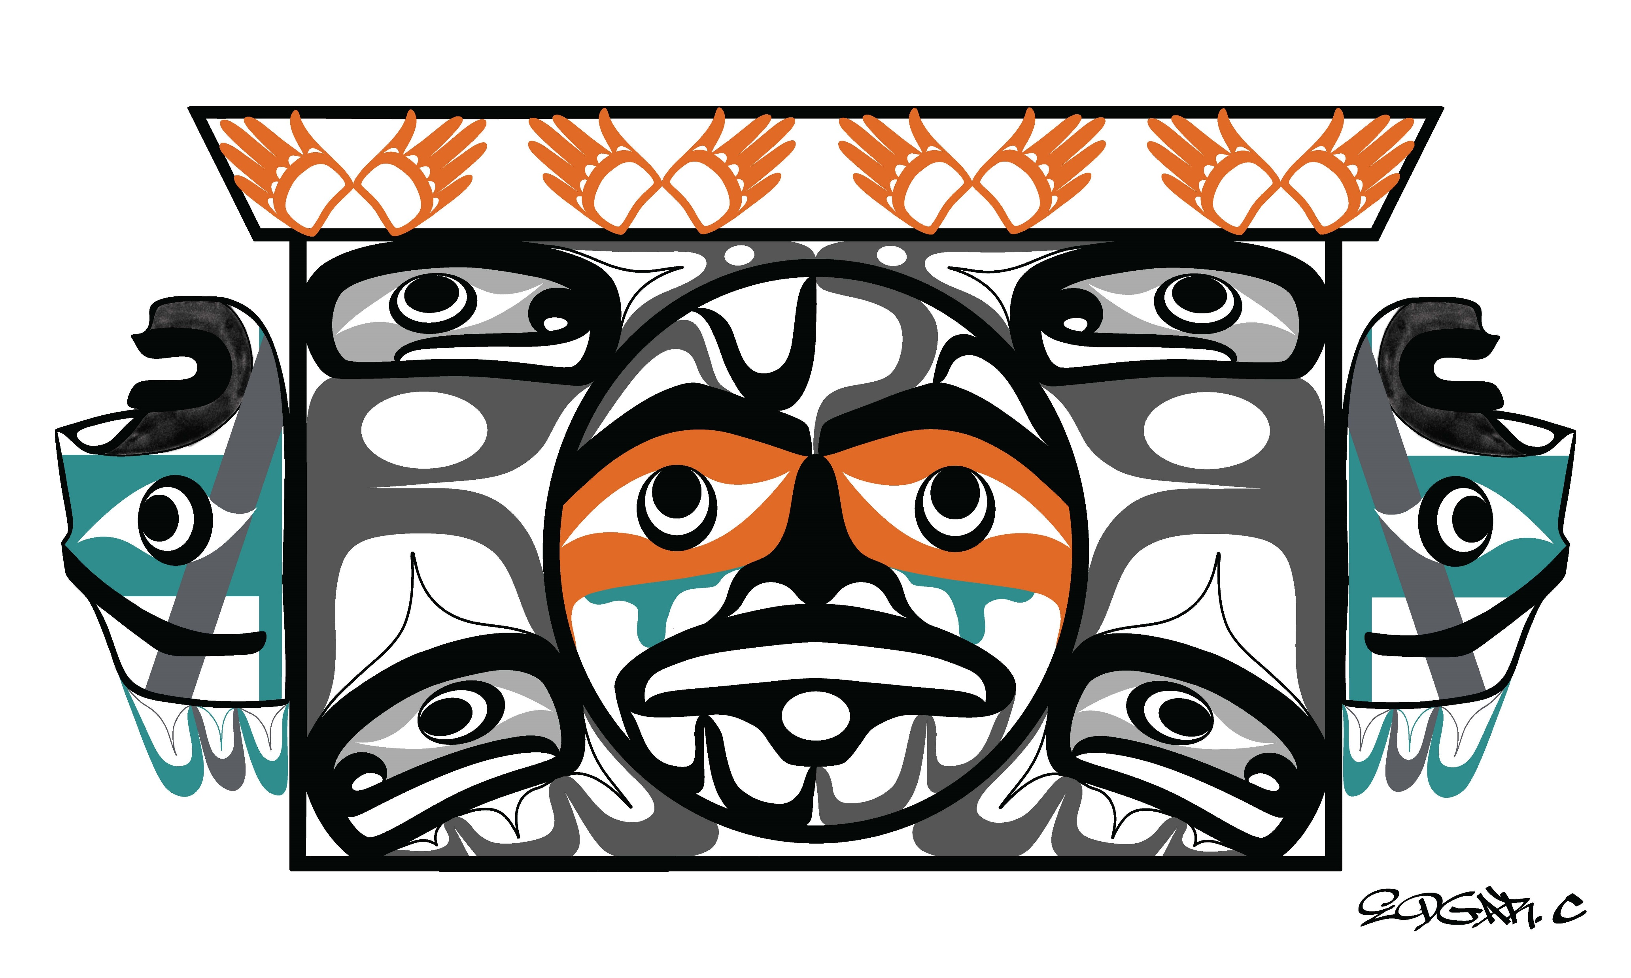
Creating Indigenous Safe Spaces for Truth Telling on Indian Boarding Schools
Truth and Healing Tribal Advisory Committee

Slide 2
Session Overview
&
Housekeeping
Session Overview
  Introduction of Tribal Advisory Committee (TAC) Members
  Background of project
  Dialogue
  Reflections
Housekeeping
  Location of bathrooms
  Preliminary Boarding School reports

Slide 3
Washington State Tribal Advisory Committee
Rebecca Black – Quinault Indian Nation
Diana Bob – Lummi Nation
Abriel Johnny – Tlingit and Cowichan First Nations
Tamika LaMere – Anishnaabe and Little Shell Chippewa
Edward Washines – Yakama Nation

Slide 4

Provisos and Background
Proviso informing the project
Extension (combined proviso with MMIWP)
Purpose: to examine and acknowledge the state’s role in perpetrating harms through the Indian boarding schools system by state, federal and religious institutions.
TAC: Elders, survivors, professionals, and community members with lived or intergenerational experience
Emphasize agency learning: Agency coming to a tribal table- moving away from giving solutions and instead centering listening first to the lived experiences of community about harms perpetrated by colonial institutions through a lens of cultural humility and respect.

Slide 5
Proviso
(9)(a) $250,000 of the general fund—state appropriation for fiscal year 2024 and $250,000 of the general fund—state appropriation for fiscal year 2025 are provided solely for the establishment of a truth and reconciliation tribal advisory committee to conduct research and outreach to understand the operations and impact of Indian boarding schools in Washington run by public and faith-based institutions, and to develop recommendations for the state to acknowledge and address the historical and intergenerational harms caused by Indian boarding schools and other cultural and linguistic termination practices.
(b) The advisory committee shall consist of five members nominated by the attorney general. The committee members must be citizens from federally recognized tribes in diverse geographic areas across the state that possess personal, policy, or specific expertise with Indian boarding school history and policies, or who have expertise in truth and healing endeavors that are traditionally and culturally appropriate.
(c) The advisory committee must hold its first meeting by September 30, 2023, and shall meet at least quarterly. The advisory committee may conduct meetings in person or virtually and must accept written testimony. The advisory committee may, when feasible, invite and consult with any entity, agency, or individual deemed necessary to further its work, or with experts or professionals involved, having expertise, or having lived experience regarding Indian boarding schools or tribal engagement.
(d) The office and the advisory committee must conduct at least six listening sessions in collaboration with tribes and Native-led organizations. The listening sessions must be held with consideration of the cultural, emotional, spiritual, and psychological well-being of survivors, family members, and community members. In planning and facilitating the listening sessions, the office must seek to avoid imposing undue burdens on survivors, family members, or community members.
(e) The office of the attorney general must administer and provide staff support for the advisory committee.

Slide 6
Proviso
(f) By June 30, 2025, the office must submit a final report to the appropriate committees of the legislature that includes, but is not limited to:
(i) A summary of activities undertaken by the advisory committee;
(ii) Findings regarding the extent and types of support provided by the state to Indian boarding schools;
(iii) Findings regarding current state policies and practices that originate from Indian boarding schools or other assimilationist policies and practices and that cause disproportionate harm to American Indian and Alaska Native people and communities; and
(iv) Recommendations regarding how the state can address the harm done by Indian boarding schools and other cultural and linguistic termination practices through a truth and reconciliation model, including but not limited to:
(A) Resources and assistance that the state may provide to aid in the healing of trauma caused by Indian boarding school policies; and
(B) Actions to correct current state policies and practices with origins in assimilationist policies or that cause disproportionate harm to Native people and communities. tate policies and practices with origins in assimilationist policies or that cause disproportionate harm to Native people and communities.

Slide 7
List of Indian Boarding Schools in Washington State
As part of our efforts to understand and address the full scope and legacy of Indian boarding schools in Washington, we are developing a list of facilities known to have operated within Washington State and/or Territory. This list is not intended to be exhaustive or final as the research into facilities operating in Washington is ongoing.
So far, we identified 27 facilities that operated in Washington State. Of these facilities, 16 received at least some form of federal support. Many others were run solely by private, religious or faith-based organizations.

Slide 8
Indian Boarding Schools in WA State
Puyallup Indian School- also, Cushman Indian School, 1857-1869 (Federal Report lists as separate facilities with Cushman not having boarding facilities)
St. George Indian Residential School- also, St. George’s Industrial School, St. George’s Mission School, St. George’s Boarding School, St. George’s Catholic Boarding School, 1888-1937
St. Leo’s Grammar and High School, 1912-1976
Tulalip Mission School- also, Tulalip Indian School, St. Anne’s Catholic Mission School, Tulalip Mission School of our Lady of Seven Dolars, Tulalip Boarding School, 1857-1902
Tulalip Indian Industrial School- also, Tulalip Training School, Tulalip Industrial Boarding School, Tulalip Agency Male and Female School, 1905-1932
Fort Simcoe Indian Boarding School- also, Yakima Indian Boarding School, Yakima Agency Boarding School, Yakima Reservation School, Yakima School, Yakima 1859-1922
Fort Spokane Boarding School- also, Colville Boarding School, Spokane School, Fort Spokane Indian School, Colville Spokane Sanatorium 1900-1914
St. Joseph’s Academy, 1888-1969
S’Kokomish Boarding and Day School- also, Skokomish School, 1866-1918
Quinaelt Boarding and Day School- also, Quinailt School, Taholah (Quinaielt) Day School, Taholah Day School, Tahola Day School, 1870-1920
Sacred Heart Academy- also, Goodwin Mission School for Indians, 1873-1921
St. Francis Regis Mission School- also, Saint Francis, St. Francis Xavier Boarding, 1873-1921
St. Mary’s Mission School- also, Pascal Sherman Boarding School, 1886- still open
Colville Mission School- also, Colville Boy’s School, Colville Girl’s School, Colville Industrial Boarding School, circa 1887- ______
St. Joseph’s Boarding School, 1888-1889
Neah Bay Boarding and Day School- also, Neah Bay Industrial Boarding School, 1890-1933
Chehalis Boarding and Day School- also, Chehalis School, Puyallup-Chehalis School, 1890-1920
Tonasket Boarding School- also, Okanagan Boarding School, 1891-1897
Quileute Day School
St. Ambrose Mission, 1891-1903
St. Joachim Mission, 1891-1903
St. Paul Mission, 1892
Boarding School for Boys, 1878-1908
Our Lady of the Seven Dolors School, 1868-1901 added to Tulalip Mission School in federal report.
School for Male Indian Boys, 1857-1878
St. Francis Xavier, 1888-1896 (second location to St. Joseph’s Academy) need to verify is separate from other listed Xavier school.
Stickney Home Mission School for Indians- also, Stickney Memorial Home and Industrial School, Stickney Day School, Nooksack Boarding School, Lummi Boarding School

Slide 9
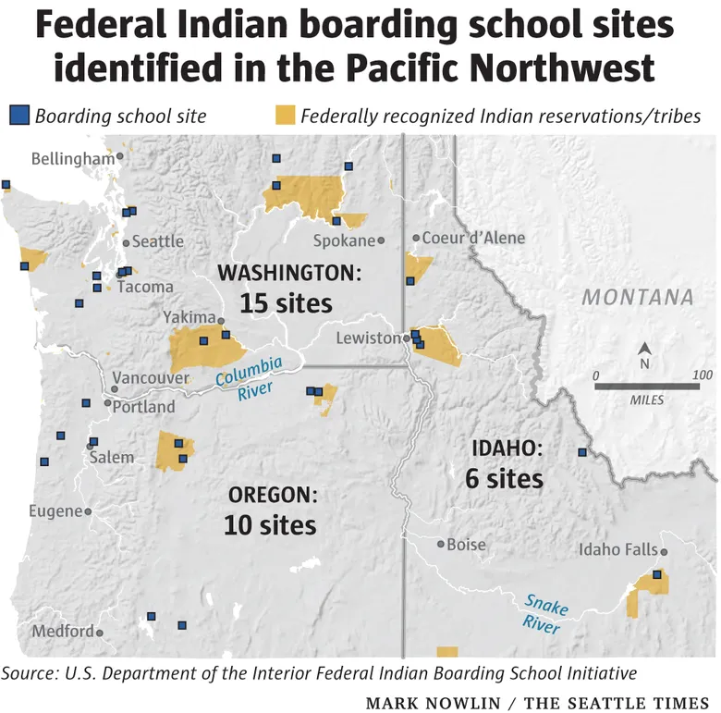
Indian Boarding Schools within Washington State

Slide 10
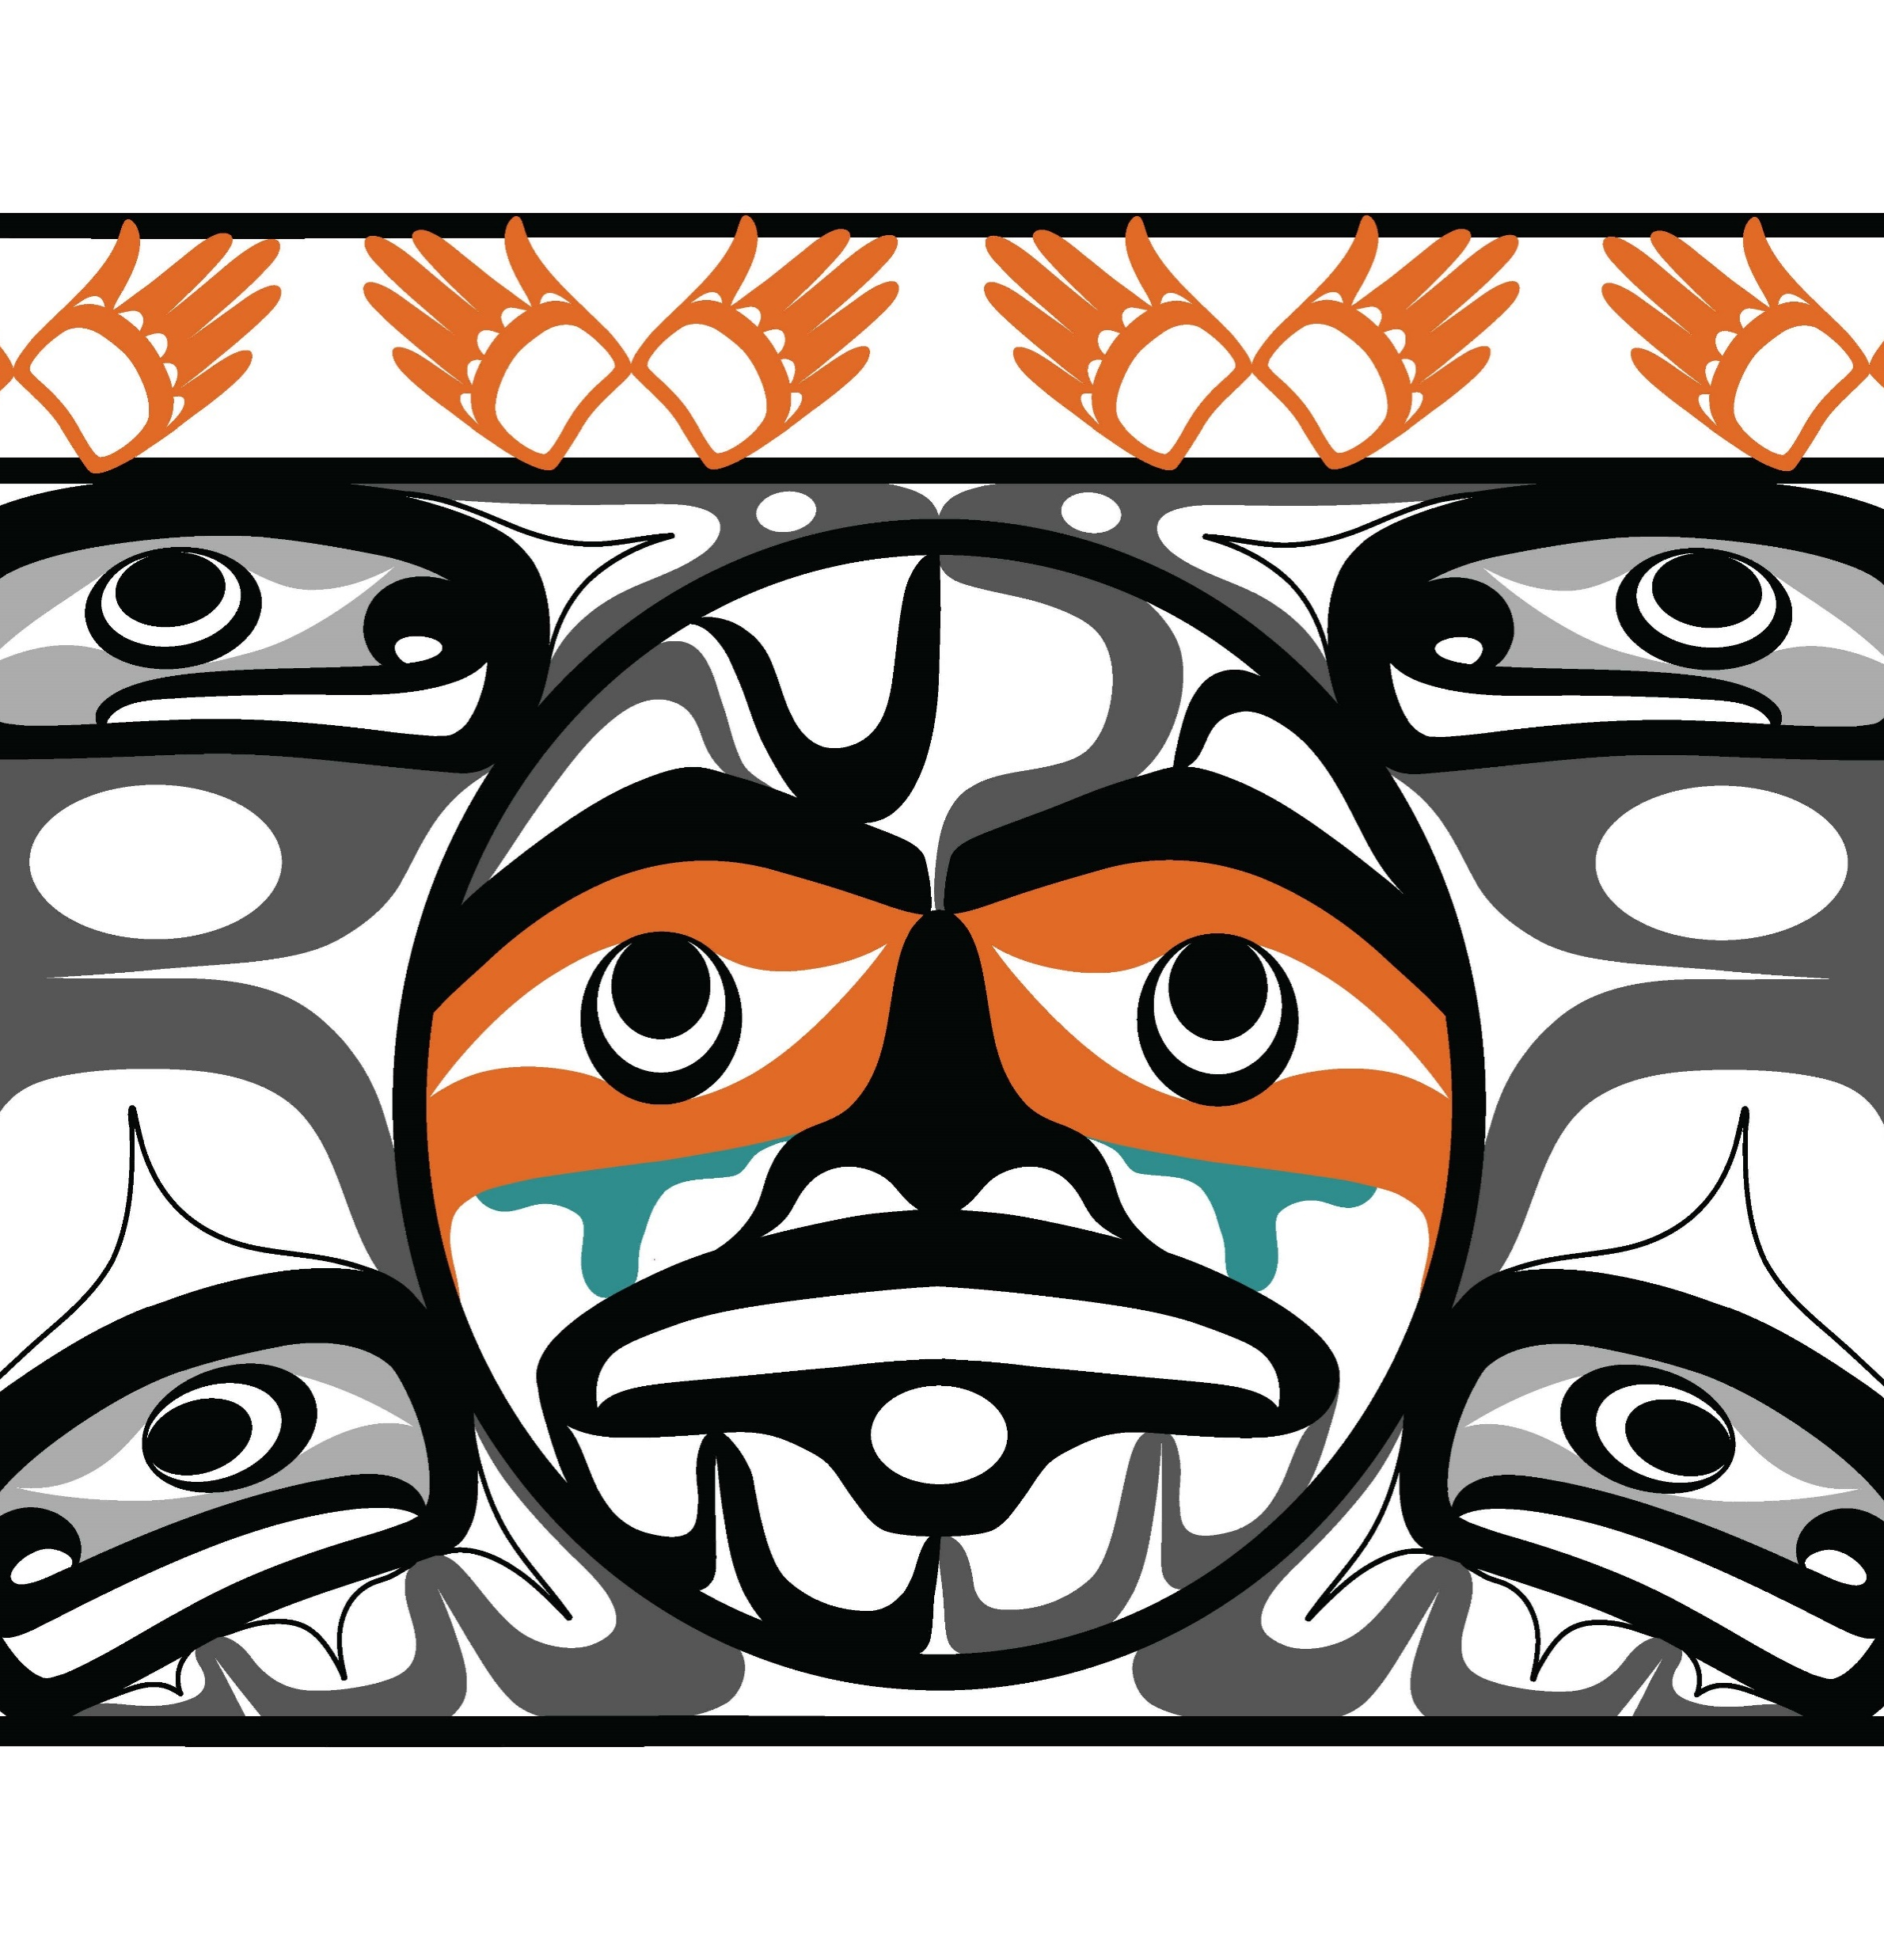
Early Lessons
The need to continue working to create “Indigenous safe spaces” within the AGO for this work to occur.
Eliminating the weaponization of language to center respectful interactions and actions.
Commitment to reducing/eliminating power imbalances.
The extractive nature of this type of research.
Assumptions about how Indian Country will receive these proviso directives.

Slide 11
Why I Can’t Hold Space for You Anymore
Systemic violence is complex and multi-layered. One thing that cuts across layers is the disproportionate amount of labor that Indigenous, Black and other racialized people bear when they are expected to teach other people about systemic colonial and racial violence.
GTDF arts/research collective: Why I Can’t Hold Space for You Anymore – Gesturing Towards Decolonial Futures
Notes:
The “why” behind the work towards staff and agency learning these lessons

Slide 12
Do You Really Want to Know Why I Can’t Hold Space for You Anymore?
Because
You see my body as an extension of your entitlements
Because
I have held space for you before
and every time, the same thing happens
You take up all the space
and expect me to use my time,
energy and emotion in service of fulfilling your desires:
to validate you as someone who is good and innocent
to be the appreciative audience for your self-expression
to provide the content of a transformative learning experience
to perform my trauma
to affirm your innocence
to celebrate your self-image
to center your feelings
to absolve you from guilt
to be always generous and generative
to filter what I say in order not to make you feel uncomfortable
to make you feel loved, important, special and safe
and you don’t even realize you are doing it
Because your support is always conditional
On whether it aligns with your agenda
On whether it is requested in a gentle way
On whether I perform a politics that is convenient for you
On whether it fits your personal brand
On whether it contributes to your legacy
On whether you will get rewarded for doing it
On whether it feels good
Or makes you look good
Or gives you the sense that we are “moving forward”
Because when you ‘give’ me space to speak
It comes with strings attached about
what I can and cannot say
and about how I can say it
You want an easy way out
A quick checklist or one-day workshop
on how to avoid being criticized
while you carry out business as usual
And even when I say what I want to say anyway
You can’t hear it
Or you listen selectively
And when you think you hear it
You consume it
You look for a way to say ‘that’s not me’
‘I’m one of the good ones’
and use what I say to criticize someone else
Or you nod empathetically and emphatically to my face and then
The next thing you do shows that while you can repeat my words
Your harmful desires and perceived entitlements remain exactly the same
And when I put my foot down or show how deeply angry or frustrated I am
You read me as ungrateful, incompetent, unreliable and betraying your confidence
You complain behind my back that I’m creating a hostile environment
You say I’m being unprofessional, emotional, oversensitive
That I need to get over it
That I’m blocking progress
That I shouldn’t be so angry
That my ancestors lost the battle
That not everything is about colonialism or racism or whiteness
That aren’t we all just people, in the end?
That we are all indigenous to some place
That you feel really connected to the earth, too
That you have an Indigenous friend/colleague/girlfriend that really likes you…
You minimize and further invizibilize my pain
Your learning
your self-actualization
your credibility
your security
and your social mobility
always come at my expense.
That is why I can’t hold space for your anymore.
GTDF arts/research collective: Why I Can’t Hold Space for You Anymore – Gesturing Towards Decolonial Futures

Slide 13
Creating “Indigenous safe spaces” within the AGO for this work to occur
Lead with relationships, not research- this restores agency to Tribes and community and lays the foundational relationships needed to enter spaces respectfully.
Ceremony as structure- this sets the appropriate tone of humility, protection and reciprocity needed to offer respect, gratitude, and center relationship building as integral to our processes.
Shared space, shared responsibility- the AGO must create spaces where community, not agency control, determines process and pace.
Notes:
This is the team’s goal, but we must acknowledge that we have a lot of learning and action to do before we can consider these concepts “learned”.

Slide 14

Eliminating the weaponization of language to center respectful interactions and actions
Language shapes relationships- the AGO must be intentional about words and actions that either reinforce colonial hierarchies or model reconciliation.
Truth telling as a process must center lived experience, the story, not data.
We are working in partnership with, not on behalf of or for, Tribes- this work can only occur after relationships are developed and we have been invited to do this work with Tribes and tribal communities.

Slide 15

Commitment to reducing/eliminating power imbalances
Government institutions historically caused and continue to cause harm to Indigenous peoples through coercive authority and erasure. The TAC’s guidance requires decentering the state/agency objectives and recentering Tribal and community voice and choice.
Co-creation: ensuring each Tribe and tribal community design listening sessions.
Equitable compensation: this research is intrinsically extractive, the AGO must exhaust all avenues to provide compensation to survivors directly for the lived experiences that make up the core of the project—this acknowledges expertise, and the emotional labor participation asks.
Continued work by the AGO to ensure staff understand both agency and personal responsibility to operate from a trauma-informed, anti-colonial perspective—the need to remove ego from this process and enter spaces with humility, centering the work through an Indigenous lens.

Slide 16
The extractive nature of this type of research
Reducing the extractive nature of the work is an ongoing effort.
Consent before inquiry- no work without prior, informed, and culturally valid consent from the Tribe and community.
A key, overarching goal of this work should center benefit to survivors and community. Much work remains to be done to ensure the work yields a tangible benefit to community.
This work is inherently retraumatizing- routes for the state to compensate survivors as a means of reducing the extractive and traumatizing nature of this type of work are currently limited.
Honoring non-participation- Tribes and/or community may decline to participate. This decision must be respected without consequence or judgment.

Slide 17

Assumptions about how Tribes and Community will receive this work
Each of the 29 tribes who share geography with Washington State are unique and sovereign. Each will have their own view on how this work should be done.
Some communities may not yet feel safe to engage.
Avoid measuring success by participation numbers. Instead, define success by relationship integrity and community defined outcomes.
Continuous review of consent- revisit and reinforce voice and choice about participation continuously throughout the project.

Slide 18

Centering TAC Guidance

Slide 19
“What does creating Indigenous safe spaces for truth telling mean?”
“What does it look like in practice?”
Notes:
Agency is struggling with this. Much work remains to be done for AGENCY to fully understand and guide meaningful change within the institution to meet this need. The AGO predates statehood- this work has been slow because of the need to evolve longstanding colonial agency structure.

Slide 20
“How can state institutions can show up “in a good way?”
Notes:
The need to incorporate for all agency staff and leadership: Staff learning around concepts such as humility, operating from an Indigenous lens, shifting from a solution-making to relationship building as foundational to work with Indigenous communities and tribes.

Slide 21
“How can/should government accountability coexist with survivor-led healing?”
Notes:
Data sovereignty, survivor agency, centering community voice, eliminating power imbalances by entering spaces with humitlity and understanding that we do not have the knowledge or permission to develop solutions for community.

Slide 22
Audience Reflection

Slide 23
Thank you
Notes:
Offer thanks in each of our languages

Slide 24
Links & References
Washington State Truth and Healing Tribal Advisory Committee, https://www.atg.wa.gov/washington-state-truth-and-reconciliation-tribal-advisory-committee
National Native American Boarding School Healing Coalition (NABS), www.boardingschoolhealing.org
“Do You Really Want to Know Why I Can’t Hold Space for You Anymore?”, GTDF Arts/Research Collective, Why I Can’t Hold Space for You Anymore – Gesturing Towards Decolonial Futures
AGO Project Staff:
Sonja McGraw, Senior Policy Analyst, sonja.mcgraw@atg.wa.gov
Victoria Williams, Policy Analyst, victoria.Williams@atg.wa.gov
Ellen Austin Hall, Deputy Director, ellen.austinhall@atg.wa.gov
Asa Washines, Tribal Liaison, asa.washines@atg.wa.gov

Slide 25
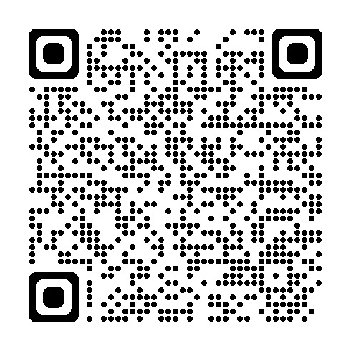
QR Code for TAC Preliminary Report
https://www.atg.wa.gov/washington-state-truth-and-reconciliation-tribal-advisory-committee

