Slide 1
Bid Rigging Detection
Rachel Lumen, Paula Pera
Assistant Attorneys General, Antitrust Division
All opinions are our own, and do not necessarily reflect the views or opinions of the Attorney General or his Office

Slide 2
Why do procurement and contracts professionals need to know about bid rigging?
It is illegal and a serious crime
It can inflate prices and harm the public, state, consumers, and tax payers
Governments are often victimized by antitrust crimes due to limited qualified contractors, barriers to entry, fewer alternatives due to higher requirements, repetitive bids, and emergency projects
Procurement and contracts professionals are the frontlines for identifying bid rigging red flags
There is a incoming influx of $3.7 Billion in federal funds to Washington from the recently passed federal Infrastructure Law
  These funds are primarily going to transportation and climate projects
Notes:
Ask questions through chat
Video off at end
$3.7 billion – there is a link to the federal government materials with more specifics about these funds and where they are going in the resources at the end of the presentation materials

Slide 3
Bid Rigging Law Overview

Slide 4
Why do we need antitrust law?
The existence of markets and competition is crucial for the success of a market economy
Aggressive competition among sellers gives consumers—both individuals and businesses—the benefits of lower prices, better products and services, more choices, and greater innovation
The antitrust laws promote and protect competition by preventing anticompetitive mergers and business practices.

Slide 5
Federal Antitrust Laws Overview
  Sherman Antitrust Act (1890)
    Original purpose was to rein in trusts
    Prohibits agreements in restraint of trade (15 U.S.C. § 1)
    Prohibits monopolization or attempted monopolization (15 U.S.C. § 2)
  Clayton Antitrust Act (1914)
    Prohibited some mergers and acquisitions “where the effect may substantially lessen competition”. (15 U.S.C. § 18)
    Gave state attorneys general the ability to enforce the federal antitrust laws.
    Amended by the Hart-Scott-Rodino Act of 1976, to require companies intending to merge to notify the federal government before consummating the transaction.

Slide 6
Washington State Antitrust Laws Overview
  Washington State Consumer Protection Act – Chapter 19.86 RCW
    Unfair competition practices
    Agreements in restraint of trade
    Monopolization and attempted monopolization
    Agreements not to deal
    Mergers and acquisitions that substantially lessen competition
  Generally tracks federal law language, though there are some substantive differences

Slide 7
Coordinated conduct: Agreements that unreasonably restrain trade
RCW 19.86.030: Agreements in restraint of trade
“Every contract, combination, in the form of trust or otherwise, or conspiracy in restraint of trade or commerce is hereby declared unlawful.”
15 U.S.C § 1 - Every contract, combination in the form of trust or otherwise, or conspiracy, in restraint of trade or commerce among the several States, or with foreign nations, is declared to be illegal.
Federal offenses can be prosecuted criminally.
Same elements, plus an interstate or international component required for federal claims.

Slide 8
Bid Rigging: Illegal agreement under antitrust laws
Bid rigging: coordinated conduct among competing bidders that undermines the bidding process
Requires an agreement
Restrains trade: defeats purpose of the bidding process
Per se illegal
  Certain agreements are so inherently bad, they are presumed harmful
  There is no acceptable justification to the behavior

Slide 9
Other Relevant Laws on Bid Rigging
Washington Criminal Law
  RCW 9.18.120 & .130 - Suppression and collusion to prevent competitive bidding
    Unlawful for any person to offer anything of value to another to induce that person to refrain from bidding or to enter into any agreement for the purpose of suppressing competition.
    Gross misdemeanor
  Enforced by county prosecutors, not the Antitrust Division of the AGO
RCW 39.26.120 requires competitive bids in state contracting when practicable.
RCW 39.26.200(2)(c) allows state to fine or debar contractors who engage in it.
May also constitute violations of the mail or wire fraud statute, the false statements statute, or other federal felony statutes, all of which DOJ prosecutes.

Slide 10
Market Conditions Conducive to Bid Rigging
Few sellers or bidders in the industry, or a small group of major vendors controls a large percentage of the market.
Competitors in the industry frequently interact through social conventions, trade association meetings, shifting employment, or when conducting legitimate business.
Bidders personally submit bids at the same physical location.
The product is standardized (commodity), and other competitive factors, such as design, quality, or service are not prevalent.
The product has no readily available substitute.

Slide 11
Types of Bid Rigging
Bid Suppression: competitors refrain to bid in favor of winning competitor.
Complementary Bidding: some competitors submit bids that are too high or otherwise unacceptable.
Bid Rotation: Conspirators take turns being the low/winning bidder.
Subcontracting: Losing bidders receive subcontracts or supply contracts from winning bidder.
Price Fixing in Bids: Competitors agree to raise price of bids.

Slide 12
Suspicious Bid Patterns
Rotating Winners
Always Winning/Losing
Inexplicable Pricing Variance
Fewer Bidders than Usual
Subcontracting to Competitor
Notes:
This may be more adequate for Rachel’s portion – I got it from a previous presentation
Rotating Winners. The same suppliers, with similar capabilities, submit bids and each company seems to take a turn being the successful bidder (bid rotation)
Always Winning/Losing. The same company always wins a particular procurement and there are other companies with similar capabilities, but either don’t bid or consistently submit higher bids (bid suppression or complementary bid)
Inexplicable Pricing Variance. Some bids are much higher than published price lists, previous bids by the same firms, or engineering cost estimates
Less Bidders than Usual. Fewer than normal competitors submit bids, and there is no economic explanation for the reduction in competitors, i.e. full workload, bankruptcy, etc.
Inexplicable Pricing Variance. A company appears to be bidding substantially higher on some bids than on other bids, with no apparent cost differences to account for the difference
Subcontracting to Competitor. A successful bidder subcontracts work to competitors that submitted unsuccessful bids on the same project

Slide 13
AG Enforcement
The Antitrust Division of the AGO enforces state and federal antitrust laws - RCW 19.86.085
AGO investigations are confidential
Investigations can stem from many sources
AGO can bring actions in the name of the state, or on behalf of persons residing in the state, including indirect purchasers.
AGO can recover damages for injury to the state and state agencies, disgorgement of ill-gotten gains, restitution for consumers, civil penalties, and costs and attorneys’ fees.

Slide 14
DOJ Enforcement:
Procurement Collusion Strike Force (PCSF)
PCSF: national effort to protect taxpayer-funded projects at the federal, state and local level from antitrust violations and related crimes.
Includes prosecutors from the DOJ’s Antitrust Division, U.S. Attorneys’ Offices, the FBI and partner Offices of Inspector General.
Outreach and training for procurement officials and government contractors on antitrust risks in the procurement process.
Jointly investigate and prosecute civil and criminal cases that result from their targeted outreach efforts.

Slide 15
Bid Rigging Case Examples

Slide 16
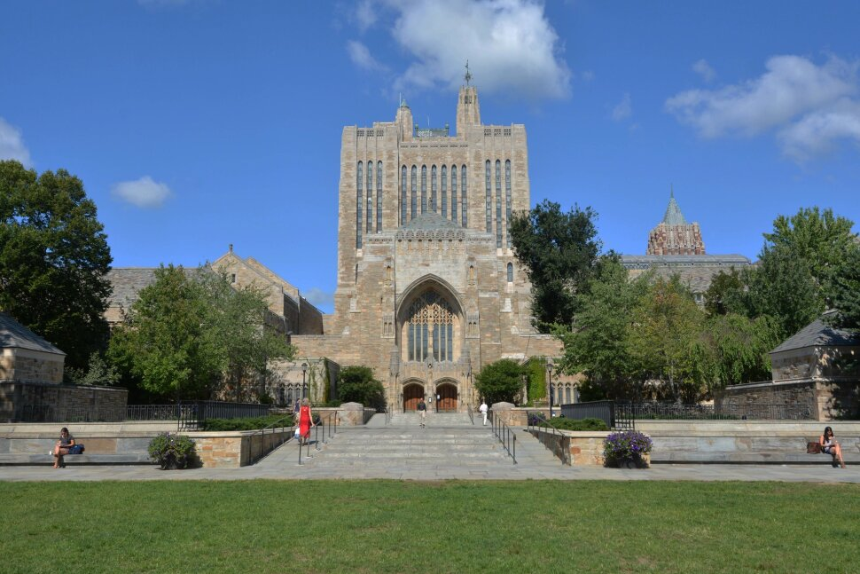
Connecticut Insulation Conspiracy
US v. Langan Insulation LLC;
  Conspired with contractors to inflate prices on public and private projects
  Subcontractor and Complementary Bidding Scheme
US v. BC Flynn Contracting Corp. and Axion Specialty Contracting LLC
  Conspired to divvy up contracts throughout Connecticut
  Market allocation/suppression bid scheme
Led to inflated prices for a variety of schools, municipalities and hospitals

Slide 17
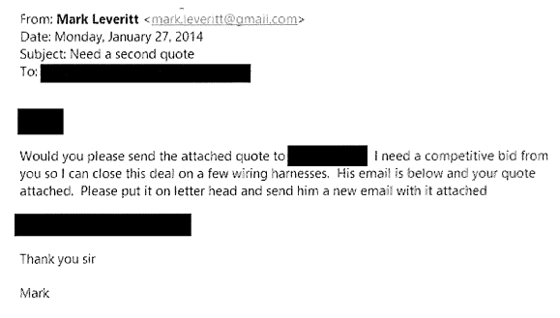
United States v. Leveritt
Leveritt and competitor made a series of competing bids for work on military bases in Texas and Michigan
  He occasionally made false bids pretending to be the competitor
  Used program meant for disabled veterans
Also provided many “gifts” to the government official overseeing the bids
Complimentary/rotation bid scheme

Slide 18
United States v. Zito
Highway concrete crack-sealing and repair company incorporated in Montana
Zito called competitor and proposed a “strategic partnership”
  Zito would stop bidding in South Dakota and Nebraska if competitor stopped bidding in Montana and Wyoming
  Zito also offered $100,000 to compensate competitor for lost business
  Zito stated he wanted to eliminate his competitor
Competitor immediately went to the US DOT Inspector General and reported Zito
Zito charged with attempted monopolization (15 U.S.C. § 2)
Market allocation/bid suppression scheme

Slide 19
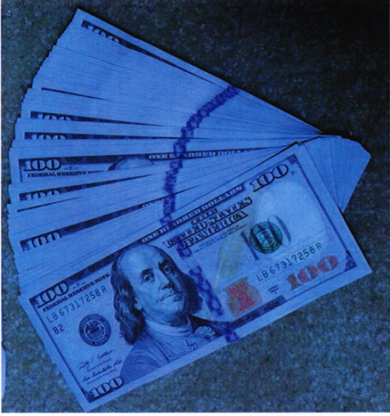
Caltrans Cases
US v. Yong; US v. Opp; US v. Miller
Facilities improvement and repair contracts
Caltrans employee received more than $800,000 in cash, furniture, wine, and home remodeling services
Complimentary bidding scheme + bribery

Slide 20
Bid Rigging Simulation
Special Thanks to Derek Whiddon from the Ohio Office of the Attorney General for Sharing Sample Simulation Materials

Slide 21
Bid Rigging Red Flags Checklist
Only two consistent bidders in the market
Inelastic demand- no practical alternatives for the product/service
Some vendors do not submit bids
Vendors say they are “no longer bidding on these accounts”
Last minute change to the bid/cross outs
Homogenous product- vendors must compete on price not a differentiated product
Companies all headquartered in same state/region
Vendor says the accounts are no longer “in their territory” or that bid “belongs” to another vendor
Possible bid rotation
Vendor consistently bids despite always losing
New entrant leaves the market soon after entering- possibly pushed out by the incumbent vendors
Similar letterheads or handwriting on bid submission forms
Familiarity among vendors
Local vendor charges more than a vendor far away
Prior winner’s bid drastically increases after a year
Grammar/math errors carried across bids
Geographic splitting of territories
Unusual equality among competitors
A key employee recently shifted companies
Grant programs- vendors may be colluding to take advantage of the program and charge higher prices
Notes:
Market - low # of competitors, product/service not changing much, no practical alternatives, influx of grant money/regular grant money
Suspicious Behaviors – vendors don’t bid, joint bidding by competitors, vendor never wins but keeps bidding, new entrants start and stop bidding, splitting of territory for winning, a key employee shifts to a competitor/starts a new competitive business, familiarity among vendors
Suspicious Applications– last minute cross outs, same letterhead, same email, same handwriting, same grammar/math errors
Suspicious Statements – “no longer bidding on those accounts” “that’s not my territory,” that “belongs to” another vendor, knowledge of a competitor’s pricing
Suspicious Pricing – bid rotation, changes to pricing that are inconsistent with market conditions, always only wins in one area (bids higher in other regions), unusual equality among competitors

Slide 22
Simulation Introduction
You are reviewing the bid responses for the Hypothetical Department of Enterprise Services bi-annual bid for recycled printing paper
You know that prices for sulfuric acid have been going up since 2014 because of a shortage
Further, this year the price of transportation has gone up due to supply chain issues
The State’s need for paper has been reducing as Washington increasingly focuses on going paperless
A special grant from the Hypothetical Inflation Reduction Act funds 20% of the cost of purchasing recycled printing paper by state governments for the next 10 years
Five vendors bid
What red flags do you see? (Type in chat)
Notes:
Homogenous product
Grant program for recycled printing paper

Slide 23
Paper Vendors
Kalama Paper
  Headquartered in Kalama, WA
  Kalama Paper is one of the oldest paper manufacturers and suppliers in WA. It was the paper supplier for a large local university before the university started an effort to go paperless.
Recycled Paper Co.
  Headquartered in Battleground, WA
  Recycled Paper is known for using recycled materials to make its paper. 85% of their business is working with city newspapers.
Paper-Pacific
  Headquartered in Vancouver, WA
  This paper company is known for the quality its paper pulp.
Quality Paper Co.
  Headquartered in Richfield, WA
  Founded by former Kalama Paper executive
Hans Paper Co.
  Headquartered in Portland, OR
  Hans Paper Co. is operated by a local college Professor Hans who continues to teach while running his paper company.
Did Not Bid: Columbus Co.
  Headquartered in Columbus, OH
  Columbus Co. bid last year for the first time, but did not bid again the year. They were a long-standing Midwest recycled paper supplier, but they typically did not bid on West Coast projects until last year.
Notes:
All bidding companies are from the same region, except for one new entrant (Columbus Paper)
Former employee of Kalama Paper founded Quality Paper
New entrant from further away did not bid again (seems pushed out of the market)

Slide 24
Bid History
2020 Bids
Kalama | $19 per ream
Recycled | $17 per ream - AWARDED
Paper-Pacific | $18 per ream
Quality | $18 per ream
Columbus Paper | $17.75 per ream
Notes: Columbus Paper’s bid included an extra $2 per ream for longer distance transportation
2022 Bids
Kalama | $25 per ream
Recycled | $26 per ream
Paper-Pacific | $24 per ream - AWARDED
Quality | $27 per ream
Note: All bids include an extra $5 due to supply chain cost inflation
Declinations: Hans Paper Co. – transitioning company, new owner didn’t know how to bid; Columbus Paper – no reason given
2016 Bids
Kalama | $14 per ream
Recycled | $15 per ream
Paper-Pacific | $13 per ream - AWARDED
Note: All bids were up $5 from the prior year due to a sulfuric acid shortage
Declinations: Quality Paper– didn’t realize bids were due, Hans Paper Co. – professor on a sabbatical and didn’t bid
2018 Bids
Kalama |  | $15 per ream - AWARDED
Recycled |  | $16 per ream
Paper-Pacific |  | $17 per ream
Quality |  | $16 per ream
Declinations: Hans Paper Co. – Prof. too busy to bid
Notes:
Big jump in winning bidder’s pricing each year
Rotated winners
Quality paper always loses
Hans paper always declines
Columbus paper didn’t re bid despite being competitive in the 2020 bid cycle

Slide 25
2022 Bid Excerpts
Paper-Pacific - $24 per ream – AWARDED
Kalama Paper - $25 per ream
 | Cost | Notes
Materials | $6
Labor | $10
Transportation | $6 | $5 increase due to Suppply chain constraints
Cost per ream: | $24 | includes profit margin
 | Cost | Notes
Materials | $6.50
Labor | $10.50
Transportation | $6 | $5 increase due to Supply chain constraints
Cost per ream: | $25 | includes profit margin
Notes:
Grammar/math errors carried across bids (Recycled Paper and Quality Paper Co. Bid)
Last minute cross outs (Quality Paper Co. Bid)
Unusual equality among competitors (exact same margin and transportation costs)

Slide 26
2022 Bid Excerpts
Recycled Paper Co. - $26 per ream
Quality Paper Co. - $27 per ream
 | Cost | Notes
Materials | $7
Labor | $11
Transportation | $6 | $5 increase due to Suppply chain constraints
Cost per ream: | $26 | includes profit margin
 | Cost | Notes
Materials | $6.50 $7.50
Labor | $10.50 $11.50
Transportation | $6 | $5 increase due to supply Suppply chain constraints
Cost per ream: | $25 $27 | includes profit margin
Notes:
Grammar/math errors carried across bids (Recycled Paper and Quality Paper Co. Bid)
Last minute cross outs (Quality Paper Co. Bid)
Unusual equality among competitors (exact same margin and transportation costs)

Slide 27
Hans Email
From: Fredrich Hans
To: Procurement Manager
Subject: Thanks for Reaching Out
Hi there,
Thank you for reaching out about the bi-annual paper bid. Hans Paper Co. is currently being transitioned to being run by my daughter Britta Hans and she did not understand the bidding process. She only recently attended the 2022 Cascadia Paper Conference for the first time. She wasn’t sure if this bid was in our territory.
Thanks again,
Fredrich Hans
Hans@Paper-Pacific.com
Notes:
Hans Paper Co.’s email address is @Paper-Pacific.com
Hans discusses a bid being potentially not in their territory, suggesting geographic allocation of markets
There is a regional paper conference (potential setting for information sharing)

Slide 28
Winning Bid Email
From: Pauline McDonald
To: Procurement Manager
Cc: Luther@QualityPaper.com
Subject: Winning Bid
Dear PM,
Thank you so much for your call telling us that Paper-Pacific was the winning bid! We are excited to provide for all your recycled paper needs. I am copying one of our subcontractors to the email so we can all be on the same page and swiftly respond to your needs.
Thank you,
Pauline McDonald
McDonald@Paper-Pacific.com
Notes:
Pauline copied Luther from Quality Paper (a competitor) to the email
Paper-Pacific seems to be subcontracting to Quality Paper Co.

Slide 29
Bid Rigging Simulation Summary
The market conditions are for a homogenous product, however, the State’s demand for paper is reducing due to go-paperless efforts
  Lower demand should increase price competition, however pricing seems to be increasing every year
Starting in 2016, a group of geographically proximate paper companies decided to start a bid rotation scheme based in part on a plausible market condition (raised cost of sulfuric acid)
Each year the companies attended the Cascadia Paper Conference prior to the HDES bid and they worked out a bid rotation
Quality Paper Co. is a fake bid. It is a company formed by a former Kalama Paper employee that gets subcontracts for making the market appear competitive, despite never winning a bid
Notes:
Rotating Winners – Kalama, Paper-Pacific, and Recycled Paper
Always Winning/Losing – Quality Paper
Inexplicable Pricing Variance – All
Fewer Bidders than Usual – Hans/Columbus Co.
Subcontracting to Competitor – Quality Paper

Slide 30
Bid Rigging Simulation Summary
Hans Paper Co. is a real company, however, they have agreed to not compete in certain areas
The influx of the new federal grant and the well-known market issues related to the supply chain and inflation have led the conspiracy to further raise rates in 2022 just as they did originally in 2016
Columbus Paper Co. seems to have been driven out of the market
Prices have raised in suspicious lock-step
Notes:
Bid Suppression: Hans
Complementary Bidding: Quality Paper
Bid Rotation: Conspirators take turns being the low/winning bidder.
Subcontracting: Losing bidders receive subcontracts or supply contracts from winning bidder.
Price Fixing in Bids: Competitors agree to raise price of bids.

Slide 31
Simulation Red Flags Answers:
Intro:
  Homogenous product
  Grant program for recycled printing paper
Paper Vendors:
  All bidding companies are from the same region, except for one new entrant (Columbus Paper)
  Former employee of Kalama Paper founded Quality Paper
  New entrant from further away did not bid again (seems pushed out of the market)
Bid History:
  Some vendors do not submit bids (Hans)
  Possible Bid rotation (PKR, KRP, RPK… +$2 last win, +$3 last win, +$4 last win), although all bids went up by $5 in 2022
  Vendor consistently bids despite always losing (Quality Paper)
  New entrant from further away did not bid again (seems pushed out of the market)
  Factoring differentiated transport cost local vendors bids are high
  Prior winner’s bid drastically increases after a year ($4 increase regardless of company)
  Unusual equality among competitors
Bid Excerpts:
  Grammar/math errors carried across bids (Recycled Paper and Quality Paper Co. Bid)
  Last minute cross outs (Quality Paper Co. Bid)
  Unusual equality among competitors (exact same margin and transportation costs)
Emails:
  Pauline copied Luther from Quality Paper (a competitor) to the email
  Paper-Pacific seems to be subcontracting to Quality Paper Co.
  Hans Paper Co.’s email address is @Paper-Pacific.com
  Hans discusses a bid being potentially not in their territory, suggesting geographic allocation of markets
  There is a regional paper conference (potential setting for information sharing)

Slide 32
What Can Contracts and Procurement Professionals Do to Address Bid Rigging?
  Identify areas in which you are sourcing or contracting that may be ripe for collusion
    e.g. commoditized products, low number of bidders, new grant-funded programs
  Review bids for bid rigging red flags
    Save the red flags checklist, have it handy
  Share the red flags list with colleagues
  Invite the Antitrust Division to give a presentation on bid rigging to other procurement or contracting groups
  If something raises red flags, report it
  Where to report:
    Legal counsel, let them know that they can report violations to the Antitrust Division of the Washington Office of the Attorney General
    Antitrust complaint form: https://fortress.wa.gov/atg/formhandler/ago/AntitrustComplaint.aspx
    The Antitrust complaint Inbox: monopoly@ATG.WA.GOV

Slide 33
QUESTIONS?

Slide 34
Resources
Enforcement
  WA AGO Antitrust Division
  Federal Trade Commission Bureau of Competition
  Department of Justice Antitrust Division
  National Association of Attorneys General Antitrust Task Force
Antitrust law guides
  WA AGO Guide to the Antitrust Laws
  FTC’s Guide to the Antitrust Laws
  DOJ's Antitrust Laws and You Guide
Statutes
  The Washington State Consumer Protection Act (RCW 19.86)
  The Sherman Antitrust Act (15 U.S.C. §§ 1-7)

Slide 35
Resources
Federal Red Flags of Collusion list: https://www.justice.gov/atr/red-flags-collusion
Interactive Map of the places that the Infrastructure Funds are going to (you can zoom in on WA): https://d2d.gsa.gov/report/bipartisan-infrastructure-law-bil-maps-dashboard
Washington State Fact Sheet on where federal Infrastructure Law funds are going to: https://www.whitehouse.gov/wp-content/uploads/2022/11/Washington-BIL-State-Fact-Sheet-Nov-22.pdf

